Slide 1

FLIPKART – WASHING MACHINE PRICE ANALYSIS

Slide 2
Objective of the Project
The Objective of this project is to analyze the pricing patterns of washing machines available on Flipkart using web scraping Exploratory Data Analysis (EDA), and data visualization techniques.
The goal is to identify key factors influencing product prices and get insights that would help the customer make well informed purchase decisions.

Slide 3
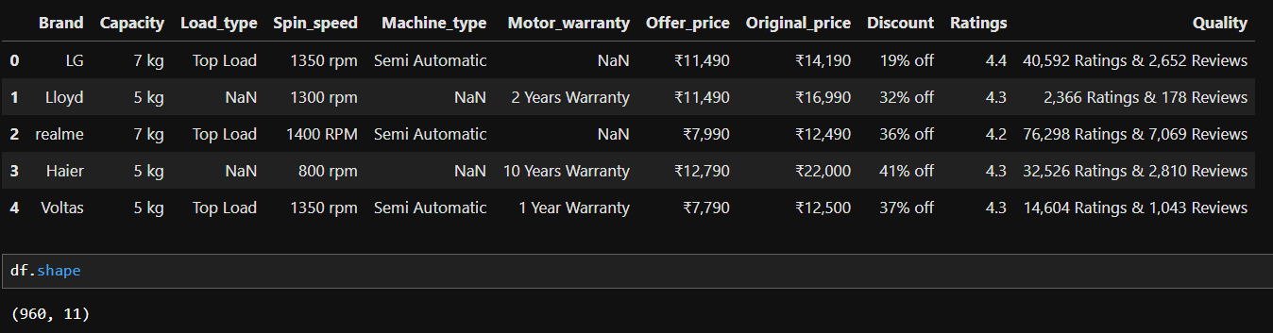
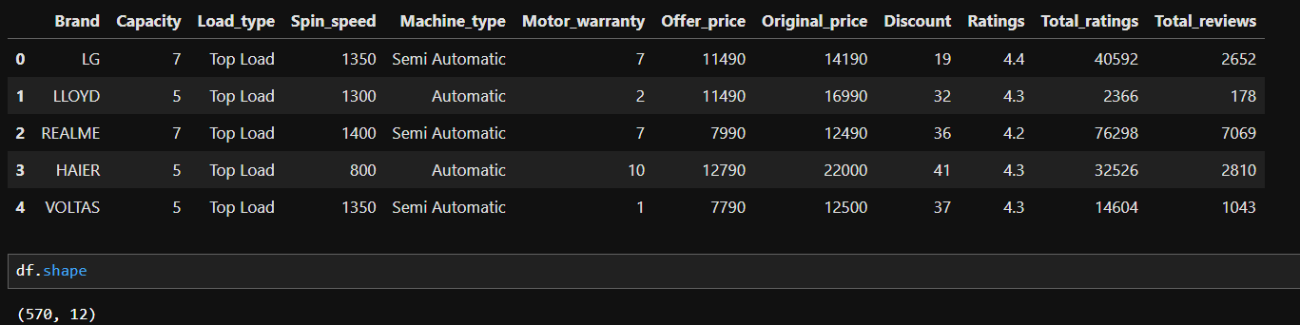
Extracted Data :-
Cleaned Data :-

Slide 4
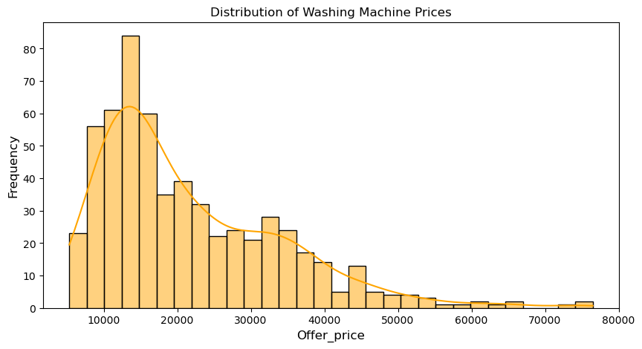
Price Distribution
Observations :
The price distribution appears right-skewed, meaning most washing
machines are in the lower price range. Median( 17,487)
There are a few high-priced machines that might be premium models.

Slide 5
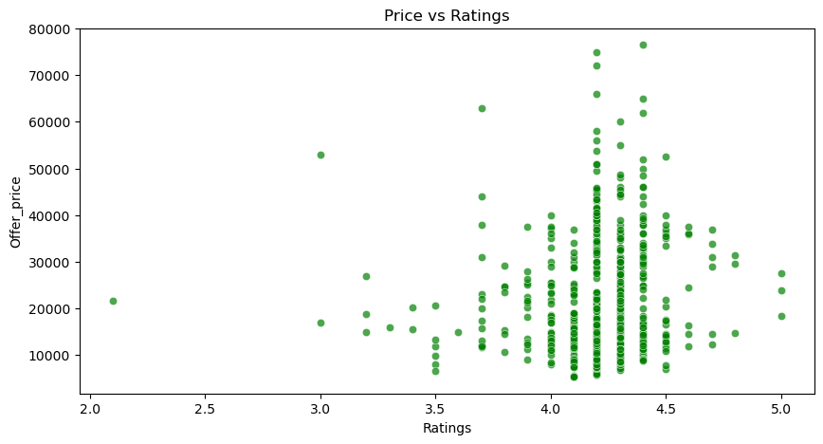
Does price affect ratings ???
Observations :
Mid-Range Priced washing machines generally have higher ratings, but ratings remain clustered between 4.0 and 4.5 across different price ranges.
Lower-priced machines also maintain decent ratings, suggesting affordability doesn’t necessarily mean poor quality.

Slide 6
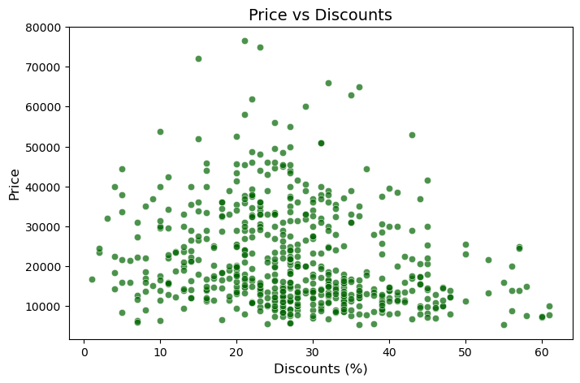
Does high price means high discount ?
Observations :
There is no clear correlation between price and discount. Higher prices do not necessarily mean higher discounts.
Expensive models tend to have lower discounts, likely due to brand positioning.
Products in the mid-price range (₹10,000 - ₹30,000) seem to receive the most frequent and consistent discounts

Slide 7
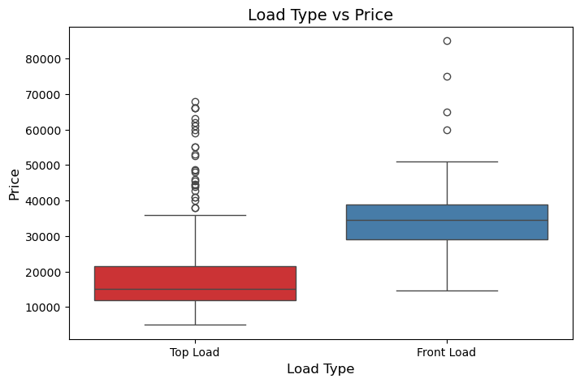
Does Load type affect price ??
Observations : -
This plot shows that Front Load machines are generally more expensive than Top Load machines, but Top Load machines have a broader price range with some higher-priced models as outliers.

Slide 8
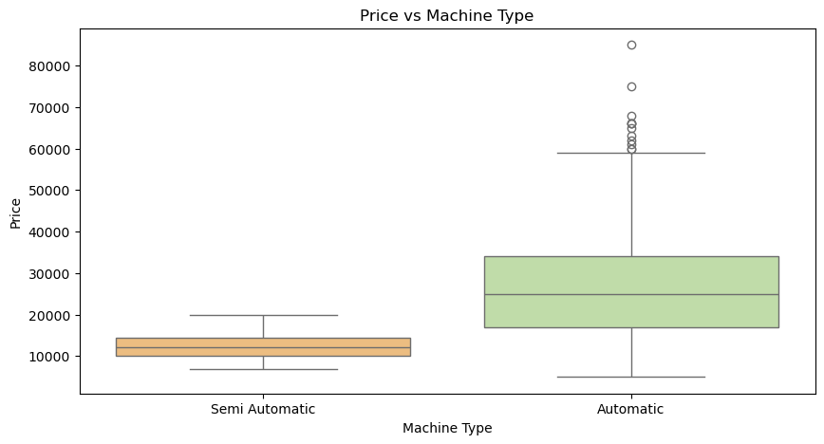
Does machine type affect price ??
Observations:
Yes fully automatic machines exhibit a larger range of prices compared to semi-automatic machines. The prices for automatic machines vary significantly, from approximately ₹20,000 to over ₹80,000 while semi-automatic machine prices are more consistent, ranging from around ₹9,000 to ₹22,000
The median price of Fully Automatic (30,000) machines is significantly higher than Semi-Automatic (12,000) machines.
This plot suggests that Fully Automatic machines are more expensive and have a greater variety in pricing compared to Semi-Automatic ones.

Slide 9
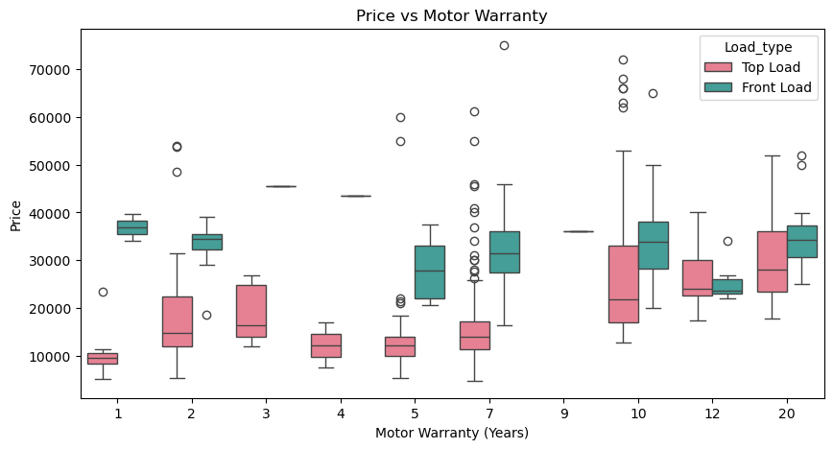
Does motor warranty affect price ??
Observations :
Some shorter warranties (like 2 years) have a broad price range, including premium models, while longer warranties (like 5, 7, 12 years) often have more moderate prices.
Washing machines with warranties ranging from 1 to 5 years generally fall into the affordable or mid-range category.
Machines with 2, 7, 10, and 20-year warranties have several outliers above 50,000. This suggests that high-end or luxury models exist within these warranty periods.

Slide 10
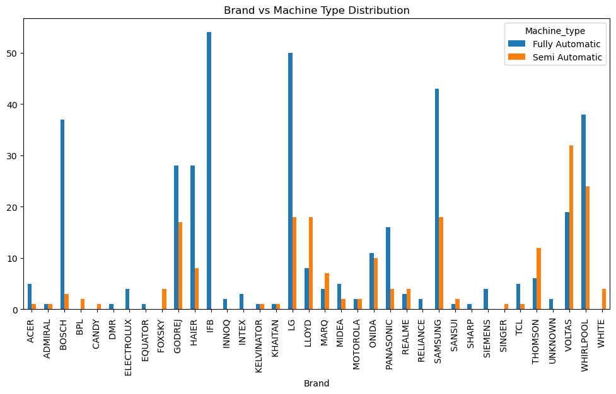
Machine type distribution
observations :
This plot highlights the dominance of Fully Automatic machines across major brands, suggesting that fully automatic machines are more favored in the market.

Slide 11
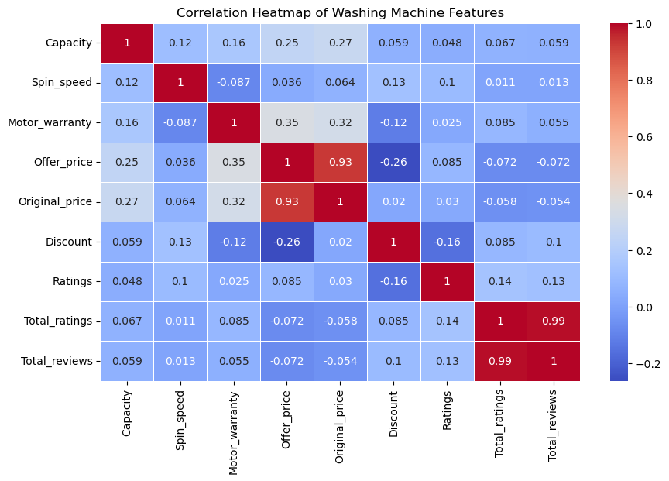
Heatmap

Slide 12
Business Key Points :-
Introduce discount campaigns targeting mid-range products (₹20,000 - ₹40,000) as they represent the highest cluster in the market. Higher discounts may be offered during peak sales seasons to maximize volume.
Encourage customers to leave reviews and ratings post-purchase through incentive programs or by integrating an easy review process. This could improve customer engagement and influence new buyer's decisions.
Highlight warranty and capacity as key selling points for premium models. Offering extended warranties as part of some offers can further increase product value.

Slide 13

THANK YOU

